Slide 1

Bella beat Case Study
User Lifestyle App Data

Slide 2
Business Question
What are some trends in smart device usage?
How could these trends apply to Bella beat customers?
How could these trends help influence Bella beat marketing strategy?

Slide 3
Table of Contents
01
02
03
Objectives
Data Analysis Process
Analysis
State the purpose of the project
Process followed in this project
Visualize the findings from the data
04
05
Insights
Recommendations
Summarize the findings
Gave recommendations based on insights

Slide 4
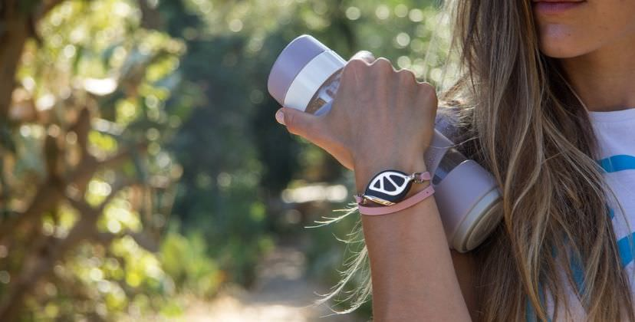
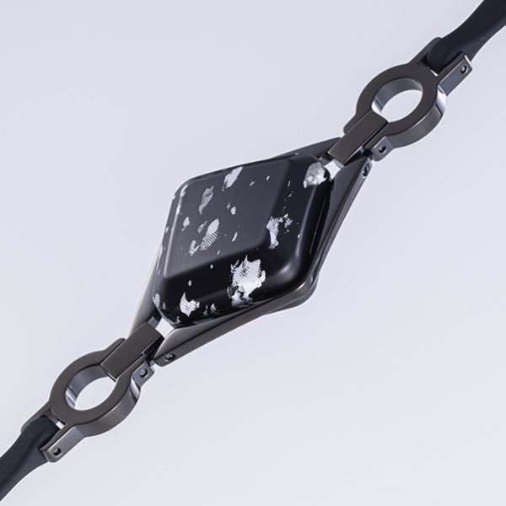
Company Background
High-tech manufacturer of health-focused products for women and develop wearables and accompanying products that monitor biometric and lifestyle data.
Product Offerings:
They offer the following products:
Bellabeat app: Daily lifestyle app
Leaf: Bellabeat’s classic wellness tracker
Time: wellness watch
Spring: Water bottle that tracks daily water intake
Bellabeat membership: Offers a subscription-based membership program for users.

Slide 5
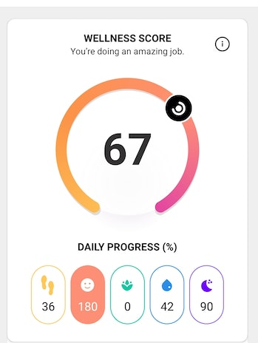
Objectives
The purpose of this study is to analyze the trends and relations between different physical activities that are a part of users’ lifestyle and draw conclusions from it.
These results help the company to come up with more innovative ideas to help user.

Slide 6
Data Analysis Process
Prepare
Analyse
Act
Ask
Process
Share

Slide 7
Data Overview
Datasets | Number of Users
dailyActivity_merged.csv | 33 users
dailyCalories_merged.csv | 33 users
dailyIntensities_merged.csv | 33 users
dailySteps_merged.csv | 33 users
sleepDay_merged.csv | 24 users

Slide 8
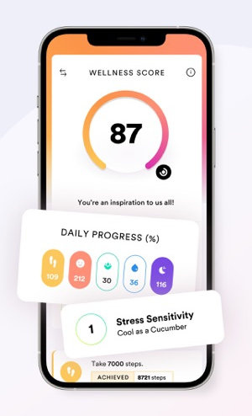
Analysis
Following physical activities has been tracked to get insights about users’ lifestyle
Minutes Spent (Active/Inactive)
Distance covered and steps taken
Calories
Sleep

Slide 9
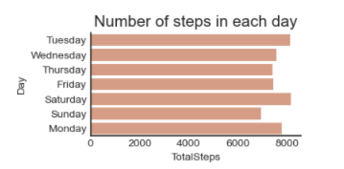
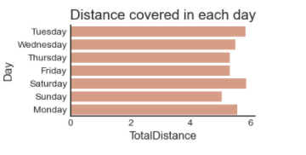
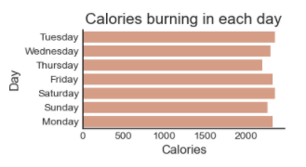
Active Days
This is the daily analysis of the user where we analyze total steps, total distance and total burnt calories
Mostly users are active on Saturday followed by Tuesday.

Slide 10
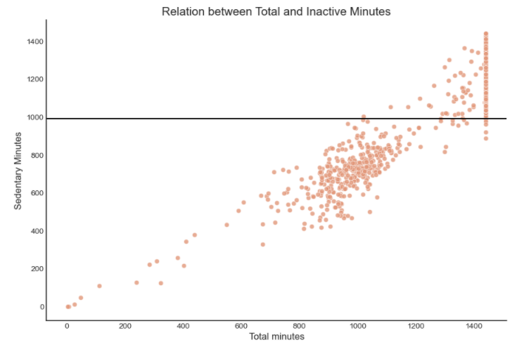
Relation between total and Inactive Minutes
Mostly users spend their time remain inactive and doesn't engage in physical activities. Users may involve in activities that does not require physical movements.
Users spend approx. 80% of their time sedentary(Inactive) while wearing the fit bit bands

Slide 11
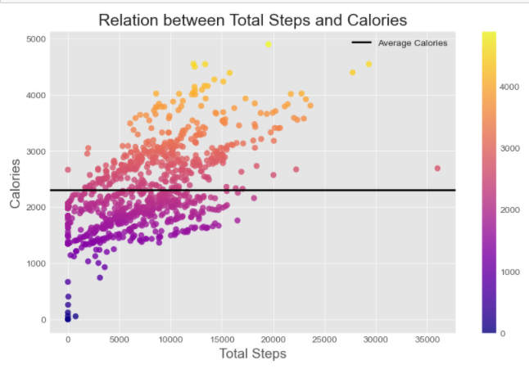
Total Calories and Steps
The higher total steps that users walk or run, more calories user burn
There is an outlier which show maximum steps 35,000. It could be an error in recording steps.
On average, the users are burning approx. 2,000 calories but the result varies. If we analyze 15,000 steps, the calories burning amount range from 2,000 to 4,000. This variety in burning calories occur due to Very Active, Fairly Active and Lightly Active User.

Slide 12
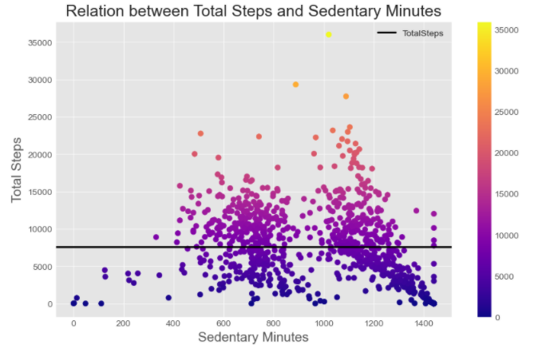
Does High Sedentary time lead to low number of steps?
Sedentary Minutes and Total Steps does not have a linear relationship.
It can be observed that number of steps will increase when sedentary minutes are from 0-500 mins, and number of steps will reduce when sedentary minutes are from 1000-1500. This is interesting, because we can recommend users who have sedentary time more than 1000 minutes should start exercising more.

Slide 13
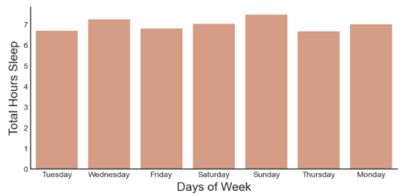
Sleep Duration
On average, users take 7.0 hours of sleep and spent approx. 39.0 minutes in bed before sleeping on daily basis.
On Sunday, people take 8 hours sleep which is high as compared to other days.

Slide 14
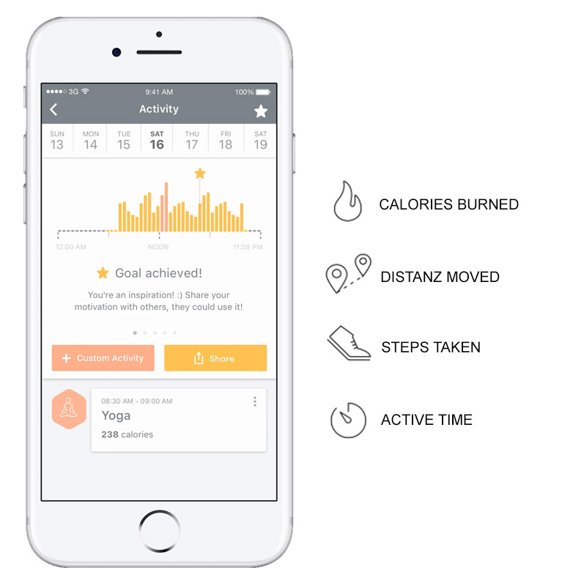
Insights
Majority (80%) of users engage in sedentary activities like working in a sitting arrangement or doing nothing.
Most users are active on Saturday followed by Tuesday. These 2 days are also the days that users burnt the highest calories in the entire week.
On average, users take 7.0 hours of sleep and spent approx. 39.0 minutes in bed before sleeping daily. On Sunday, people take 8 hours of sleep which is high as compared to other days.
People are not using lifestyle products but are not consistent with following good healthy habits and making proper steps, sleeping, and spending their time more actively.

Slide 15
Recommendations:
Social Media Campaign
Spread awareness about heathy lifestyle
Social Media Campaign
Incorporation of Bella beat app and device to improve lifestyle
Social Media Campaign
Positioning of their brand as a lifestyle product with trendy products and
Blog Post
Post daily short articles and blogs to share harmful effects of unhealthy lifestyle
Notification Alert
Should be displayed to remind them if they are inactive or their bedtime to make them consistent and remindful about following healthy habits.
Goal Setting Calculator
Design a matrix where users get recommended physical activities according to his/her biological traits which should be adopted by them.

Slide 16

Thank
You!
mhadiqa7998@gmail.com
/hadiqamalik
/hadiqamalik

